Slide 1
Practical – 7 DevOps – Part 3
Aruna Kumbhar

Slide 2
DevOps Lab: Automated Log Analyzer
Industry Scenario
In a software company, applications continuously generate log files. DevOps/support engineers need to identify how many errors, warnings and informational messages are present in the logs.
The organization wants a simple automated tool that reads an application log file and produces a summary.
Build this tool to understand the complete DevOps lifecycle:
Jira → Python → Pytest → Git → GitHub → GitHub Actions CI → Docker → Terraform → GitHub Actions CD → Deployment

Slide 3
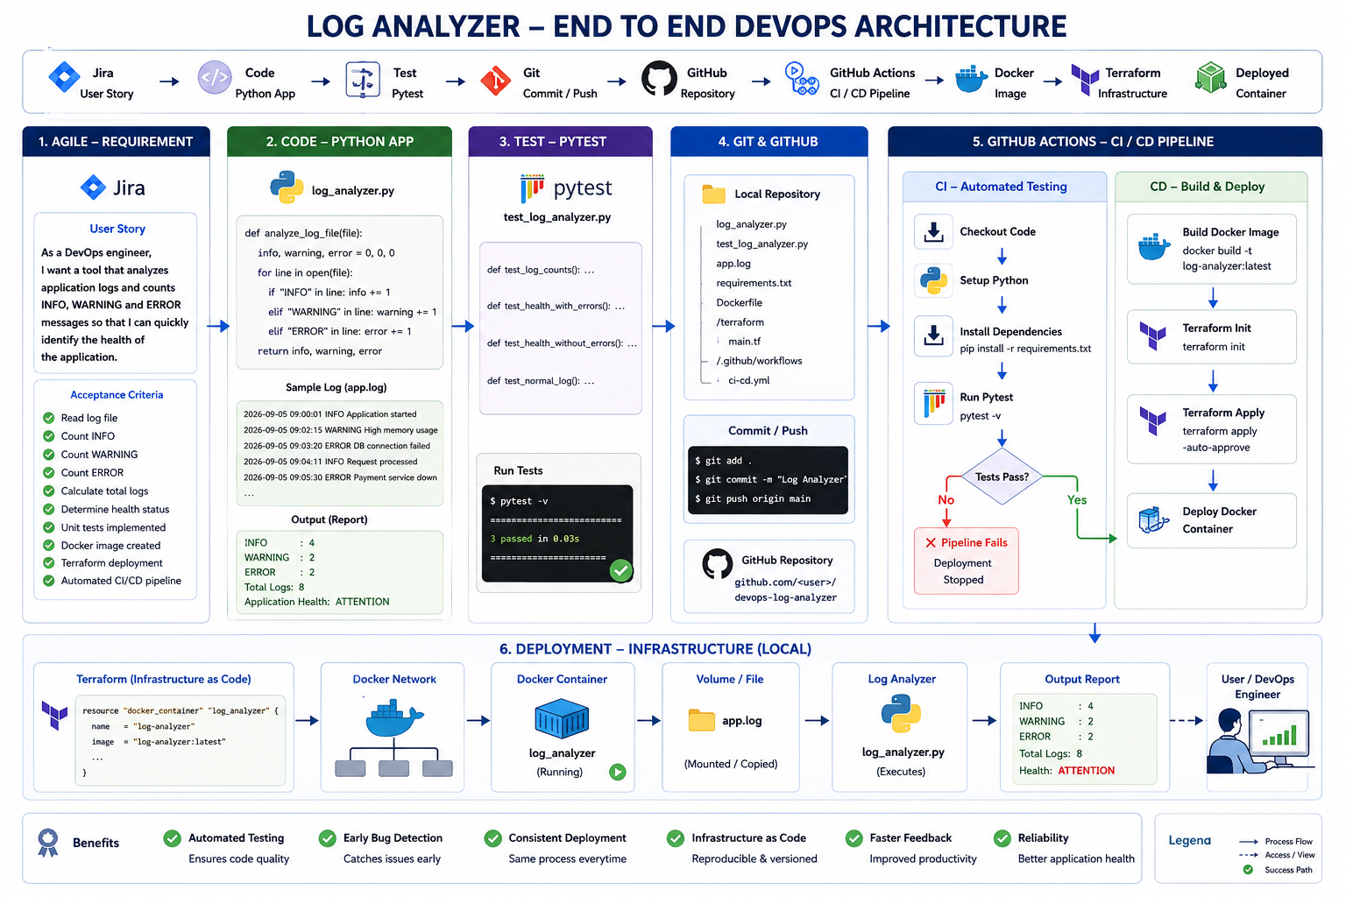

Slide 4
Problem Statement:
Develop a Python-based Log Analyzer that reads an application log file and counts the number of INFO, WARNING and ERROR messages. The application should display a summary of the log contents and identify whether the application health is NORMAL or requires ATTENTION.
The program should produce:
Example log file:
================================
LOG ANALYSIS REPORT
================================
INFO : 4
WARNING : 2
ERROR : 2
Total Logs: 8
Application Health: ATTENTION
================================
2026-09-05 09:00:01 INFO Application started
2026-09-05 09:01:10 INFO Database connection successful
2026-09-05 09:02:15 WARNING High memory usage
2026-09-05 09:03:20 ERROR Database connection failed
2026-09-05 09:04:11 INFO Request processed
2026-09-05 09:05:30 ERROR Payment service unavailable
2026-09-05 09:06:40 WARNING Response time is high
2026-09-05 09:07:50 INFO Application running

Slide 5
STEP 1: Create Jira User Story, subtasks and estimate each task
Story Title: Develop Automated Application Log Analyzer
Description: As a DevOps engineer, I want a tool that analyzes application logs and counts INFO, WARNING and ERROR messages so that I can quickly identify whether an application requires attention.
Acceptance Criteria:
Application counts INFO messages.
Application counts WARNING messages.
Application counts ERROR messages.
Application displays the total number of log entries.
Application reports NORMAL when there are no ERROR messages.
Application reports ATTENTION when one or more ERROR messages are present.
Automated unit tests are created using pytest.
All automated tests must pass before deployment.
Application is packaged as a Docker image.
Terraform is used to create the local Docker infrastructure.
GitHub Actions automatically executes the tests.
GitHub Actions builds the Docker image after successful testing.
GitHub Actions deploys the application using Terraform.

Slide 6
STEP 2: Clone Existing Github Repository on the local machine
STEP 3: Create folder structure as below
devops-log-analyzer/
│
├── log_analyzer.py
├── test_log_analyzer.py
├── app.log
├── requirements.txt
├── Dockerfile
│
├── terraform/
│ └── main.tf
│
└── .github/
└── workflows/
└── ci-cd.yml

Slide 7
STEP 4: Write a python application for log analyser and test locally
def get_health_status(error_count):
if error_count == 0:
return "NORMAL"
return "ATTENTION"
def display_report(filename):
info, warning, error = analyze_log_file(filename)
total = info + warning + error
health = get_health_status(error)
print("================================")
print(" LOG ANALYSIS REPORT")
print("================================")
print(f"INFO : {info}")
print(f"WARNING : {warning}")
print(f"ERROR : {error}")
print(f"\nTotal Logs: {total}")
print(f"\nApplication Health: {health}")
print("================================")
if __name__ == "__main__":
display_report("app.log")
def analyze_log_file(filename):
info_count = 0
warning_count = 0
error_count = 0
with open(filename, "r") as file:
for line in file:
if "INFO" in line:
info_count += 1
elif "WARNING" in line:
warning_count += 1
elif "ERROR" in line:
error_count += 1
return info_count, warning_count, error_count

Slide 8
STEP 5: Write a pytest file for automated testing
from log_analyzer import analyze_log_file
from log_analyzer import get_health_status
def test_log_analysis():
info, warning, error = analyze_log_file("app.log")
assert info == 4
assert warning == 2
assert error == 2
def test_health_with_errors():
assert get_health_status(2) == "ATTENTION"
def test_health_without_errors():
assert get_health_status(0) == "NORMAL"

Slide 9
STEP 6: Push the code into Github Repository
STEP 7: Create CI pipeline
name: Log Analyzer CI-CD
on:
push:
branches:
- main
pull_request:
branches:
- main
jobs:
test:
runs-on: ubuntu-latest
steps:
- name: Checkout Code
uses: actions/checkout@v4
- name: Setup Python
uses: actions/setup-python@v5
with:
python-version: "3.12"
- name: Install Dependencies
run: |
pip install -r requirements.txt
- name: Run Automated Tests
run: |
pytest -v

Slide 10
STEP 8: Add dependency in requirement.txt
Add pytest in requirements.txt file
STEP 9: Push the CI code into Github Repository and check the pipeline
STEP 10: Dockerize the Application
FROM python:3.12-slim
WORKDIR /app
COPY app.py .
CMD ["python", "app.py"]
docker build -t log-analyzer:latest .
docker run log-analyzer:latest

Slide 11
STEP 11: Terraform – Local Infrastructure
terraform {
required_providers {
docker = {
source = "kreuzwerker/docker"
version = "~> 3.0"
}
}
}
provider "docker" {}
resource "docker_network" "log_network" {
name = "log-analyzer-network"
}
resource "docker_container" "log_analyzer" {
name = "log-analyzer"
image = "log-analyzer:latest"
networks_advanced {
name = docker_network.log_network.name
}
}
terraform init
terraform plan
terraform apply
Terraform
│
▼
Docker Network
│
▼
Docker Container
│
▼
Log Analyzer

Slide 12
STEP 11: Configure self-hosted runner in Settings -> Actions -> Runner
STEP 112: Run complete CI/CD

